Slide 1
Place; Distribution channel Management; Channel functions and strategy; Channel structure; Channel behaviour and organisation; Channel management decisions; Process of supply chain management; Distribution channel and strategy
MODULE – 7

Slide 2
Course Outcomes
Course Outcome | Description | Bloom’s Taxonomy Level
PO3/PEO2 | Defining distribution channels and explaining its strategy with case examples | Evaluate (5)

Slide 3
Marketing Channels and Value Networks
Marketing channels
Sets of interdependent organizations participating in the process of making a product or service available for use or consumption
Intermediaries: merchants, agents, and facilitators
Marketing channel System
The particular set of marketing channels a firm employs
Push vs. pull strategy
Multichannel marketing
Using two or more marketing channels to reach customer segments in one market area
Omnichannel marketing
Integrated marketing channel system

Slide 4
Marketing Channels and Value Networks
Value Networks
A system of partnerships and alliances that a firm creates to source, augment and deliver its offerings
Demand chain planning-The company should first think of the target market, however, and then design the supply chain backward from that point.
https://www.retailgear.com/value-network
Oracle relies on 15 million developers—the largest developer community in the world.
Apple Developer—where folks create iPhone apps for the Apple operating system—has 275,000 registered iOS members.

Slide 5
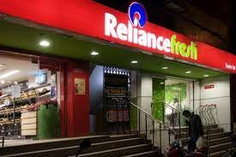
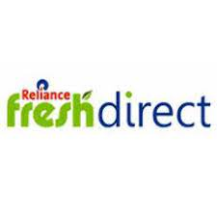
Disney
Disney sells its videos through multiple channels:
movie rental merchants such as Netflix and Redbox,
Disney Stores (now owned and run by The Children’s Place),
retail stores such as Best Buy, online retailers such as Disney’s own online stores and Amazon.com,
and the Disney Club catalog and other catalog sellers.
This variety affords Disney maximum market coverage and enables it to offer its videos at a number of price points.

Slide 6
Managing Value network
Managing a value network means making increasing investments in information technology (IT) and software.
Firms have introduced supply chain management (SCM) software and invited such software firms as SAP and Oracle to design comprehensive enterprise resource planning (ERP) systems to manage cash flow, manufacturing, human resources, purchasing, and other major functions within a unified framework. They hope to breakup departmental silos—in which each department acts only in its own self-interest—and carry out core business Processes more seamlessly.
Marketers, for their part, have traditionally focused on the side of the value network that looks toward the customer, adopting customer relationship management (CRM) software and practices. In the future, they will increasingly participate in and influence their companies’ upstream activities and become network managers, not just product and customer managers.

Slide 7
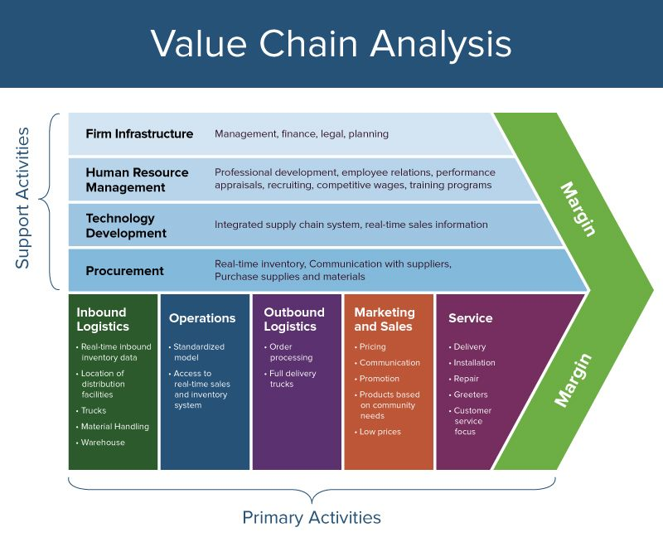

Slide 9
Coach Coach markets a high-end line of luxury handbags, briefcases, luggage, and accessories. In its 2013 fiscal year 10-K, the company describes its multichannel global distribution model as follows: “Coach products are available in image-enhancing locations globally wherever our consumer chooses to shop including: retail stores and factory outlets, directly operated shop-in-shops, online, and department and specialty stores. This allows Coach to maintain a dynamic balance as results do not depend solely on the performance of a single channel or geographic area.”
The North America segment consists of direct-to-consumer and indirect channels and includes sales to consumers through 351 company-operated retail stores, including the Internet, and sales to wholesale customers and distributors. Coach began as a U.S. wholesaler and still sells to 1,000 U.S. department-store locations, such as Macy’s (including Bloomingdale’s), Dillard’s, Nordstrom, Saks Fifth Avenue, and Lord & Taylor, often within a tightly controlled shop-within-a-shop, as well as on some of those retailer’s Web sites. This segment represented approximately 69 percent of the company’s total net sales in fiscal 2013.
The International segment sells to consumers online and through company-operated stores in Japan and mainland China, Hong Kong, Macau, Singapore, Taiwan, Malaysia, and Korea and to wholesale customers and distributors. Coach also has store-in-store offerings in Japan and China inside major department stores. The International segment represented approximately 31 percent of total net sales in fiscal 2013. Finally, Coach has licensing relationships with Movado (watches), Jimlar (footwear), and Marchon (eyewear). These licensed products are sometimes sold in other channels such as jewelry stores, high-end shoe stores, and optical retailers as Coach continues to broaden its meaning from a “bag brand” to a whole lifestyle brand.

Slide 10
Omnichannel
Companies are increasingly employing digital distribution strategies, selling directly online to customers or through e-merchants who have their own Web sites. In doing so, these companies are seeking to achieve Omnichannel marketing, in which multiple channels work seamlessly together and match each target customer’s preferred ways of doing business, delivering the right product information and customer service regardless of whether customers are online, in the store, or on the phone.
Omnichannel marketing is the integration and cooperation of the various channels organizations use to interact with consumers, with the goal of creating a consistent brand experience. This includes physical (e.g. stores) and digital channels (e.g. websites)

Slide 11
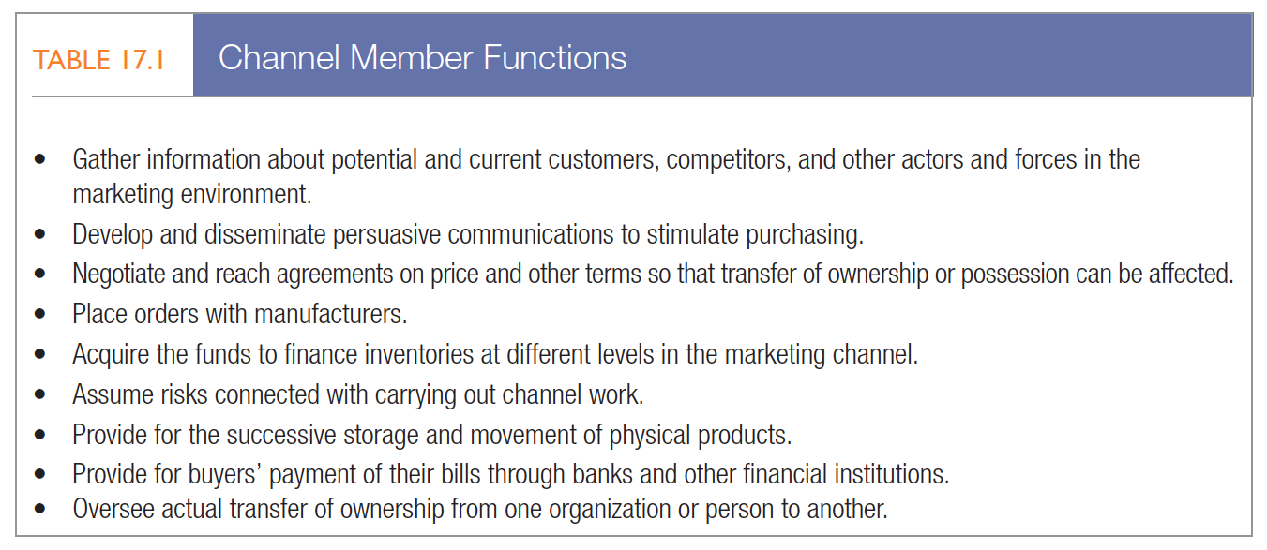
Marketing Channels and Value Networks
Channel functions and flows

Slide 13
Channel Functions and Flows
Some of these functions (storage and movement, title, and communications) constitute a forward flow of activity from the company to the customer;
others (ordering and payment) constitute a backward flow from customers to the company.
Still others (information, negotiation, finance, and risk taking) occur in both directions.
A manufacturer selling a physical product and services might require three channels: a sales channel, a delivery channel, and a service channel.

Slide 14
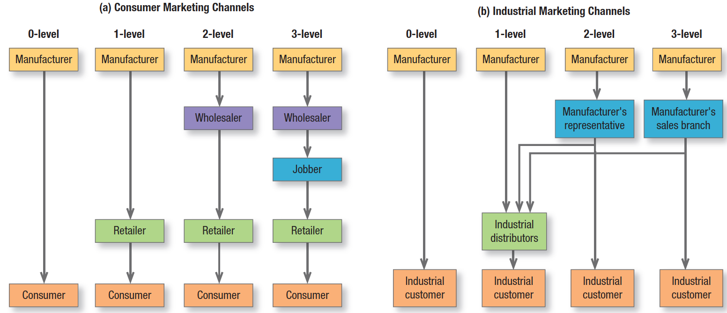
Consumer/Industrial Marketing Channel Levels
Marketing Channels and Value Networks

Slide 15
Channel-Design Decisions
1.Analyzing customer needs and wants
2.Establishing objectives and constraints
3.Identifying major channel alternatives
Types of intermediaries (Intensive, Selective, Exclusive)
Number of intermediaries
Terms/responsibilities of channel members
4.Evaluating major channel alternatives
Economic criteria
Control and adaptive criteria

Slide 16
1.Analyzing Customer Needs and Wants
Consumers may choose the channels they prefer based on price, product assortment, and convenience as well as their own shopping goals (economic, social, or experiential).
Channel segmentation exists, and marketers must be aware that different consumers have different needs during the purchase process.
Even the same consumer, though, may choose different channels for different reasons.

Slide 17
Channels produce five service outputs:
1.Desired lot size—The number of units the channel permits a typical customer to purchase on one occasion.
In buying cars for its fleet, Hertz prefers a channel from which it can buy a large lot size; a household wants a
channel that permits a lot size of one.
2. Waiting and delivery time—The average time customers wait for receipt of goods. Customers increasingly
prefer faster delivery channels.
3. Spatial convenience—The degree to which the marketing channel makes it easy for customers to purchase the
product. Toyota offers greater spatial convenience than Lexus because there are more Toyota dealers, helping
customers save on transportation and search costs in buying and repairing an automobile.
4. Product variety—The assortment provided by the marketing channel. Normally, customers prefer a greater
assortment because more choices increase the chance of finding what they need, though too many choices can
sometimes create a negative effect.
5. Service backup—Add-on services (credit, delivery, installation, repairs) provided by the channel. The more
service backup, the greater the benefit provided by the channel.

Slide 18
2.Channel objectives vary with product characteristics & environment
Bulky products, such as building materials, require channels that minimize the shipping distance and the amount of handling.
Nonstandard products such as custom built machinery are sold directly by sales representatives.
Products requiring installation or maintenance services, such as heating and cooling systems, are usually sold and maintained by the company or by franchised dealers.
High-unit-value products such as generators and turbines are often sold through a company sales force rather than intermediaries.
Marketers must adapt their channel objectives to the larger environment.

Slide 19
3. Identifying major channel alternatives
Exclusive distribution severely limits the number of intermediaries. It’s appropriate when the producer wants to ensure more knowledgeable and dedicated efforts by the resellers, and it often requires a closer partnership with them.
Exclusive distribution is used for new automobiles, some major appliances, and some women’s apparel brands. Exclusive distribution often includes exclusive dealing arrangements, especially in markets increasingly driven by price. When the legendary Italian designer label Gucci found its image severely tarnished by overexposure from licensing and discount stores, it decided to end contracts with third-party suppliers, control its distribution, and open its own stores to bring back some of the luster.
Selective distribution relies on only some of the intermediaries willing to carry a particular product. Whether established or new, the company does not need to worry about having too many outlets; it can gain adequate market coverage with more control and less cost than intensive distribution.
Intensive distribution places the goods or services in as many outlets as possible. This strategy serves well for snack foods, soft drinks, newspapers, candies, and gum—products consumers buy frequently or in a variety of locations. Convenience stores such as 7-Eleven and Circle K and gas-station outlets like ExxonMobil’s On the Run survive by providing simple location and time convenience.

Slide 20
Terms and Responsibilities of Channel Members
Price policy calls for the producer to establish a price list and schedule of discounts and allowances that intermediaries see as equitable and sufficient.
• Conditions of sale refers to payment terms and producer guarantees. Most producers grant cash discounts
to distributors for early payment. They might also offer a guarantee against defective merchandise or price
declines, creating an incentive to buy larger quantities.
• Distributors’ territorial rights define the distributors’ territories and the terms under which the producer
will enfranchise other distributors. Distributors normally expect to receive full credit for all sales in their territory,
whether or not they did the selling.
• Mutual services and responsibilities must be carefully spelled out, especially in franchised and exclusive agency
channels. McDonald’s provides franchisees with a building, promotional support, a record-keeping
system, training, and general administrative and technical assistance. In turn, franchisees are expected to
satisfy company standards for the physical facilities, cooperate with new promotional programs, furnish requested
information, and buy supplies from specified vendors, as well as pay monthly franchisee fees.

Slide 21
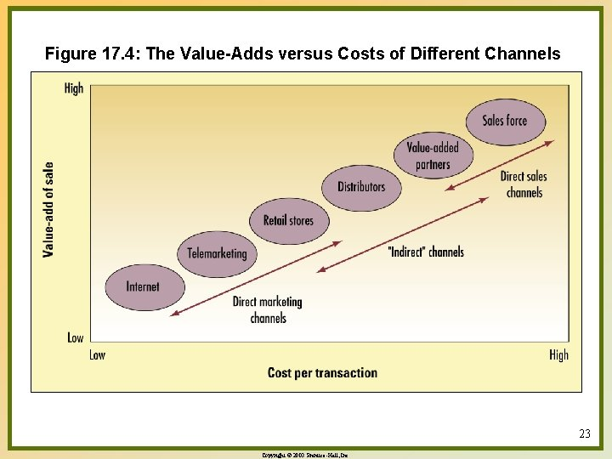
Evaluating Major Channel Alternatives
Each channel alternative needs to be evaluated against economic, control, and adaptive criteria.

Slide 22
Control and Adaptive Criteria
Control and Adaptive Criteria Using a sales agency can pose a control problem.
Agents may concentrate on the customers who buy the most, not necessarily those who buy the manufacturer’s goods.
They might not master the technical details of the company’s product or handle its promotion materials effectively.
To develop a channel, members must commit to each other for a specified period of time. Yet these commitments invariably reduce the producer’s ability to respond to change and uncertainty. The producer needs channel structures and policies that provide high adaptability.

Slide 23
Marketing Channels and Value Networks
Channel Management Decisions
Selecting channel members
Training channel members
Global Channel considerations
Evaluating channel members
Channel modification decisions
Modifying channel design

Slide 24
1.Selecting Channel Members
To customers, the channels are the company. Consider the negative impression customers would get of McDonald’s, Shell Oil, or Mercedes-Benz if one or more of their outlets or dealers consistently appeared dirty, inefficient, or unpleasant.
To facilitate channel member selection, producers should determine what characteristics distinguish the better intermediaries—
Number of years in business,
Other product lines carried,
Growth and profit record,
Financial strength,
Cooperativeness,
And service reputation.

Slide 25
Training and Motivating Channel Members
A company needs to view its intermediaries the same way it views its end users. It should determine their needs and wants and tailor its channel offering to provide them with superior value.
Carefully implemented training, market research, and other capability-building programs can motivate and
improve intermediaries’ performance.
The company must constantly communicate that intermediaries are crucial partners in a joint effort to satisfy end users of the product.

Slide 26
Channel Partnerships
Channel Partnerships More sophisticated companies try to forge a long-term partnership with distributors.
The manufacturer clearly communicates what it wants from its distributors in the way of market coverage, inventory levels, marketing development, account solicitation, technical advice and services, and marketing information and may introduce a compensation plan for adhering to the policies.
To streamline the supply chain and cut costs, many manufacturers and retailers have adopted efficient consumer
response (ECR) practices to organize their relationships in three areas:
(1) demand-side management, or collaborative practices to stimulate consumer demand by promoting joint marketing and sales activities,
(2) supply-side management, or collaborative practices to optimize supply (with a focus on joint logistics and supply
chain activities), and
(3) enablers and integrators, or collaborative information technology and process improvement tools to support joint activities that reduce operational problems, allow greater standardization, and so on.
Research has shown that although ECR has a positive impact on manufacturers’ economic performance and capability development, manufacturers may also feel they are inequitably sharing the burdens of adopting it and not getting as much as they deserve from retailers.

Slide 27
Evaluating Channel Members
Producers must periodically evaluate intermediaries’ performance against such standards
as sales-quota attainment,
average inventory levels,
customer delivery time,
treatment of damaged and lost goods, and
Cooperation in promotional and training programs.

Slide 28
Modifying Channel Design and Arrangements
Modifying Channel Design and Arrangements
No channel strategy remains effective over the whole product life cycle. In competitive markets with low entry barriers, the optimal channel structure will inevitably change over time.
New technologies have created digital channels undreamed of years ago.
The change could mean adding or dropping individual market channels or channel members or developing a totally new way to sell goods

